Slide 1
Business Intelligence and Decision Support Systems
(9th Ed., Prentice Hall)
Chapter 13:
Advanced Intelligent Systems

Slide 2
Learning Objectives
Understand the basic concepts and definitions of machine-learning
  Learn the commonalities and differences between machine learning and human learning
  Know popular machine-learning methods
Know the concepts and definitions of case-based reasoning systems (CBR)
Be aware of the MSS applications of CBR
Know the concepts behind and applications of genetic algorithms
Understand fuzzy logic and its application in designing intelligent systems

Slide 3
Learning Objectives
Understand the concepts behind support vector machines and their applications in developing advanced intelligent systems
Know the commonalities and differences between artificial neural networks and support vector machines
Understand the concepts behind intelligent software agents and their use, capabilities, and limitations in developing advanced intelligent systems
Explore integrated intelligent support systems

Slide 4
Opening Vignette:
“Machine Learning Helps Develop an Automated Reading Tutoring Tool”
Background on literacy
Problem description
Proposed solution
Results
Answer and discuss the case questions

Slide 5
Machine Learning Concepts and Definitions
Machine learning (ML) is a family of artificial intelligence technologies that is primarily concerned with the design and development of algorithms that allow computers to “learn” from historical data
  ML is the process by which a computer learns from experience
  It differs from knowledge acquisition in ES: instead of relying on experts (and their willingness) ML relies on historical facts
  ML helps in discovering patterns in data

Slide 6
Machine Learning Concepts and Definitions
Learning is the process of self-improvement, which is an critical feature of intelligent behavior
Human learning is a combination of many complicated cognitive processes, including:
  Induction
  Deduction
  Analogy
  Other special procedures related to observing and/or analyzing examples
Notes:
Induction
Deduction
Analogy
الحث
المستقطع
تشبيه

Slide 7
Machine Learning Concepts and Definitions
Machine Learning versus Human Learning
  Some ML behavior can challenge the performance of human experts (e.g., playing chess)
  Although ML sometimes matches human learning capabilities, it is not able to learn as well as humans or in the same way that humans do
  There is no claim that machine learning can be applied in a truly creative way
  ML systems are not anchored in any formal theories (why they succeed or fail is not clear)
  ML success is often attributed to manipulation of symbols (rather than mere numeric information)
Notes:
لا يوجد ادعاء بأنه يمكن تطبيق التعلم الآلي بطريقة إبداعية حقًا
أنظمة ML غير مثبتة في أي نظريات رسمية (سبب نجاحها أو فشلها غير واضح)
غالبًا ما يُعزى نجاح ML إلى التلاعب بالرموز (بدلاً من مجرد المعلومات الرقمية)

Slide 8
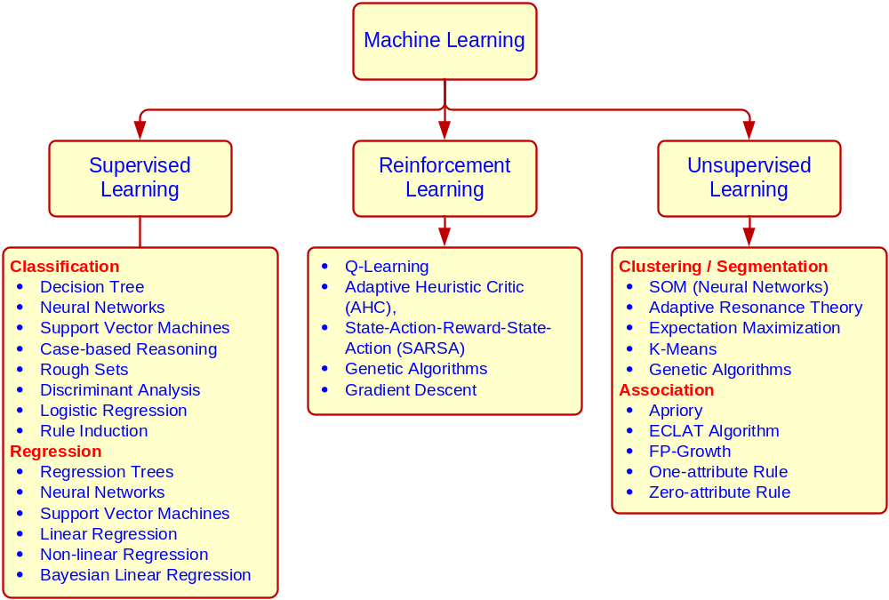
Machine Learning Methods

Slide 9
Case-Based Reasoning (CBR)
Case-based reasoning (CBR)
A methodology in which knowledge and/or inferences are derived directly from historical cases/examples
  Analogical reasoning (= CBR)
  Determining the outcome of a problem with the use of analogies. A procedure for drawing conclusions about a problem by using past experience directly (no intermediate model?)
  Inductive learning
  A machine learning approach in which rules (or models) are inferred from the historic data

Slide 10
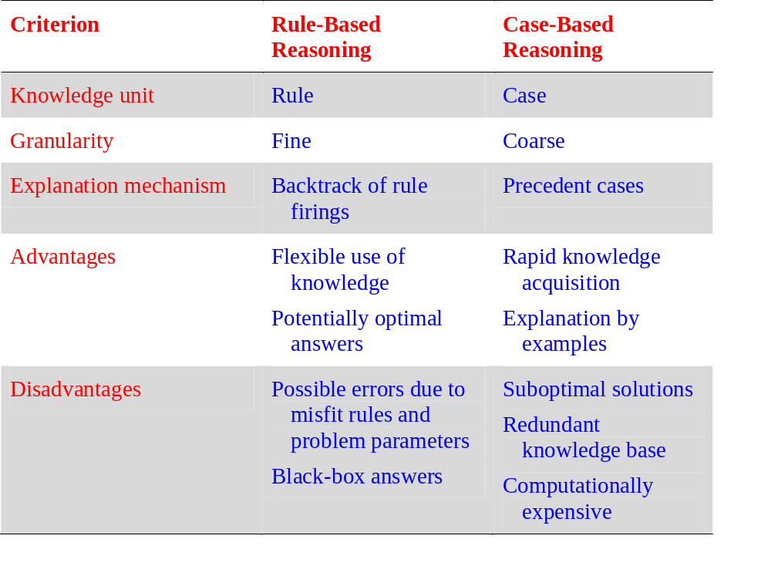
CBR vs. Rule-Based Reasoning

Slide 11
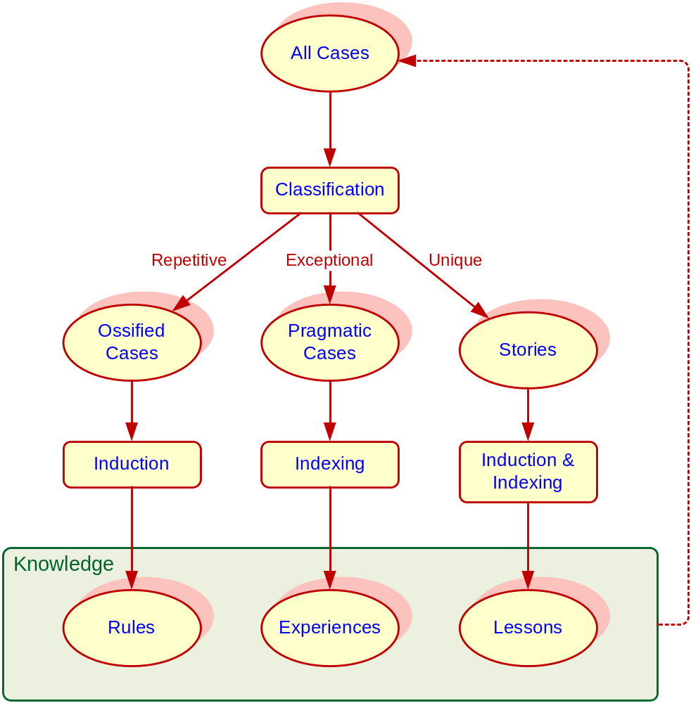
Case-Based Reasoning (CBR)
CBR is based on the premise that new problems are often similar to previously encountered problems, and, therefore, past successful solutions may be of use in solving the current situation

Slide 12
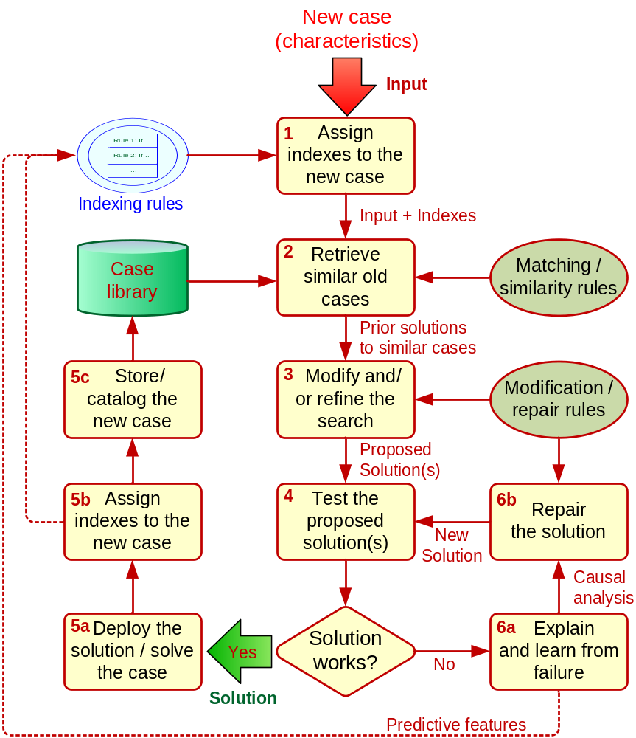
The CBR Process
The CBR Process (4R)
  Retrieve
  Reuse
  Revise
  Retain (case library)

Slide 13
Case-Based Reasoning (CBR)
Advantages of using CBR
  Knowledge acquisition is improved
  System development time is faster
  Existing data and knowledge are leveraged
  Formalized domain knowledge is not required
  Experts feel better discussing concrete cases
  Explanation becomes easier
  Acquisition of new cases is easy
  Learning can occur from both successes and failures
  …more…

Slide 14
Case-Based Reasoning (CBR)
Issues and challenges of CBR
  What makes up a case?
  How can we represent cases in memory?
  Automatic case-adaptation can be very complex!
  How is memory organized (the indexing rules)?
  How can we perform efficient searching (i.e., knowledge navigation) of the cases?
  How can we organize the cases?
  The quality of the results is heavily dependent on the indexes used
  … more …

Slide 15
Case-Based Reasoning (CBR)
Success factors for CBR systems
  Determine specific business objectives
  Understand your end users (the customers)
  Obtain top management support
  Develop an understanding of the problem domain
  Design the system carefully and appropriately
  Plan an ongoing knowledge-management process
  Establish achievable returns on investment (ROI) and measurable metrics
  Plan and execute a customer-access strategy
  Expand knowledge generation and access across the enterprise

Slide 16
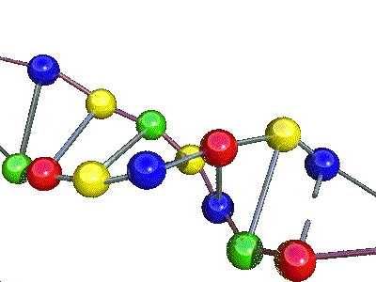
Genetic Algorithms
It is a type of machine learning technique
Mimics the biological process of evolution
Genetic algorithms
  Software programs that learn in an evolutionary manner, similar to the way biological systems evolve
An efficient, domain-independent search heuristic for a broad spectrum of problem domains
Main theme: Survival of the fittest
  Moving towards better and better solutions by letting only the fittest parents to create the future generations

Slide 17
Evolutionary Algorithm
10010110
01100010
10100100
10011001
01111101
. . .
. . .
. . .
. . .
10010110
01100010
10100100
10011101
01111001
. . .
. . .
. . .
. . .
Elitism
Selection
Reproduction
. Crossover
. Mutation
Current
generation
Next
generation
Notes:
Reproduction
. Crossover
. Mutation
التكاثر
. عبور
. طفره

Slide 18
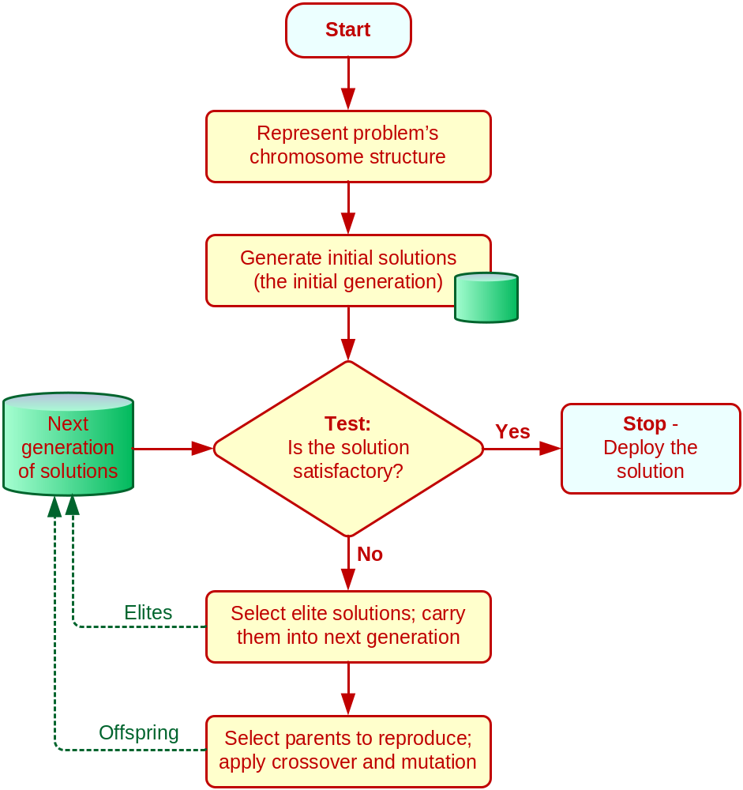
GA Structure and GA Operators
Each candidate solution is called a chromosome
A chromosome is a string of genes
Chromosomes can copy themselves, mate, and mutate via evolution
In GA we use specific genetic operators
  Reproduction
    Crossover
    Mutation

Slide 19

GA Example: The Knapsack Problem
Item: 1 2 3 4 5 6 7
Benefit: 5 8 3 2 7 9 4
Weight: 7 8 4 10 4 6 4
Knapsack holds a maximum of 22 pounds
Need to fill it for maximum benefit (one per item)
Solutions take the form of a string of 1’s
Example Solution: 1 1 0 0 1 0 0
Means choose items 1, 2, 5:
  Weight = 19, Benefit = 20
Evolver solution works in Excel
Notes:
Position of 1th from left to wright : 1,2,5

Slide 20
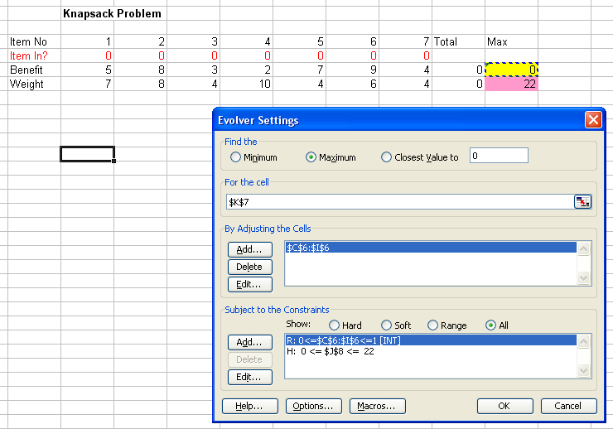
Define the objective function and constraint(s)

Slide 21
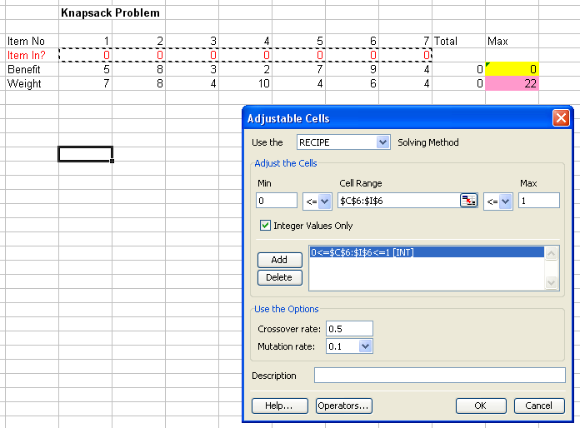
Identify the decision variables and their characteristics

Slide 22
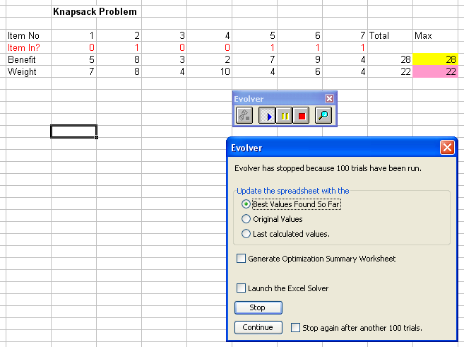
Observe and analyze the results

Slide 23
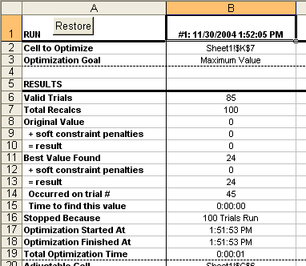
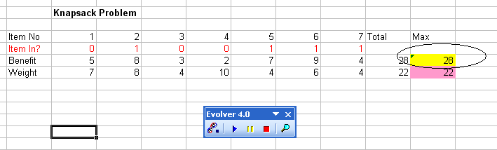
Observe and analyze the results

Slide 24
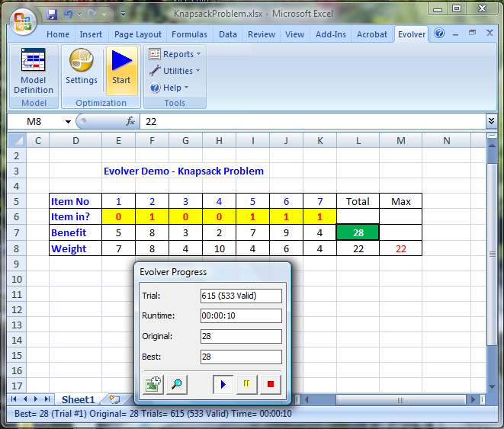
The Knapsack Problem at Evolver
Monitoring the solution generation process…

Slide 25
Genetic Algorithms
Limitations of Genetic Algorithms
  Does not guarantee an optimal solution (often settles in a sub optimal solution / local minimum)
  Not all problems can be put into GA formulation
  Development and interpretation of GA solutions requires both programming and statistical skills
  Relies heavily on the random number generators
  Locating good variables for a particular problem and obtaining the data for the variables is difficult
  Selecting methods by which to evolve the system requires experimentation and experience

Slide 26
Genetic Algorithm Applications
Dynamic process control
Optimization of induction rules
Discovery of new connectivity topologies (NNs)
Simulation of biological models of behavior
Complex design of engineering structures
Pattern recognition
Scheduling, transportation and routing
Layout and circuit design
Telecommunication, graph-based problems

Slide 27
Fuzzy Logic and Fuzzy Inference System
Fuzzy logic is a superset of conventional (Boolean) logic that has been extended to handle the concept of partial truth – truth values between "completely true" and "completely false”
First introduced by Dr. Lotfi Zadeh of UC Berkeley in the 1960's as a mean to model the uncertainty of natural language.
Uses the mathematical theory of fuzzy sets
Simulates the process of normal human reasoning
Allows the computer to behave less precisely
Decision making involves gray areas

Slide 28
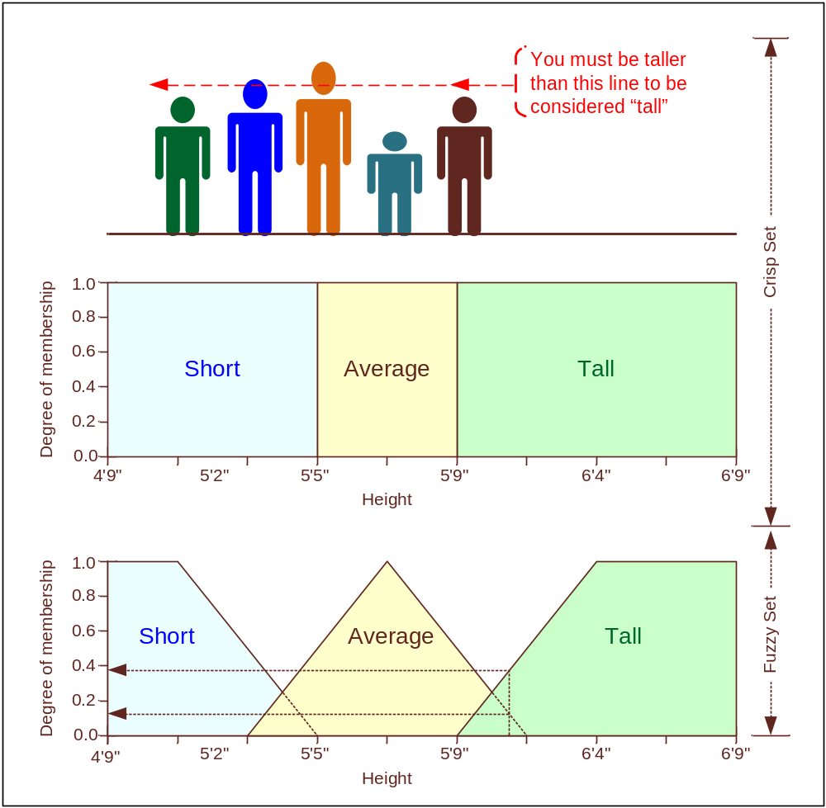
Fuzzy Logic Example: Tallness
Proportion
Height Voted for
5’10” 0.05
5’11” 0.10
6’00” 0.60
6’01” 0.15
6’02” 0.10
Jack is 6 feet tall
  Probability theory - cumulative probability: There is a 75 percent chance that Jack is tall
  Fuzzy logic: Jack's degree of membership within the set of tall people is 0.75

Slide 29
Advantages of Fuzzy Logic
More natural to construct
Easy to understand - Frees the imagination
Provides flexibility
More forgiving
Shortens system development time
Increases the system's maintainability
Uses less expensive hardware
Handles control or decision-making problems not easily defined by mathematical models
…more…

Slide 30
Fuzzy Inference System (FIS)
= Expert System + Fuzzy Logic
An FIS consists of
  A collection of fuzzy membership functions
  A set of fuzzy rules called the rule base
  Fuzzy inference is a method that interprets the values in the input vector and, based on some set of rules, assigns values to the output vector
In an FIS, the reasoning process consists of
  Fuzzification
  Inferencing
  Composition, and
  Defuzzification
Notes:
في FIS ، عملية التفكير تتكون من
التشويش
الاستنتاج
تكوين و
التشويه

Slide 31
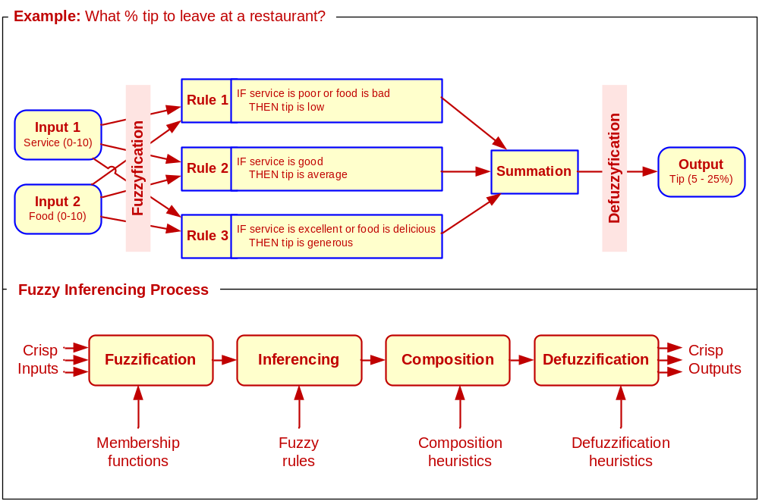
The Reasoning Process for FIS
(the tipping example)
“Given the quality of service and the food, how much should I tip?”
Notes:
composition heuristicتكوين مجريات الأمور
defuzzation heuristicاستكشافية التشويه

Slide 32
Fuzzy Applications
In Manufacturing and Management
  Space shuttle vehicle orbiting
  Regulation of water temperature in shower heads
  Selection of stocks to purchase
  Inspection of beverage cans for printing defects
  Matching of golf clubs to customers' swings
  Risk assessment, project selection
  Consumer products (air conditioners, cameras, dishwashers), …
In Business
  Strategic planning
  Real estate appraisals and valuation
  Bond evaluation and portfolio design, …
Notes:
Real estate appraisals and valuation
Bond evaluation and portfolio design
التثمين والتثمين العقاري
تقييم السندات وتصميم المحفظة

Slide 33
Neural Networks
Attempts to mimic brain functions
50 to 150 billion neurons in brain
Neurons grouped into networks
  Axons send outputs to cells
  Received by dendrites, across synapses
Analogy, not accurate model

Slide 34
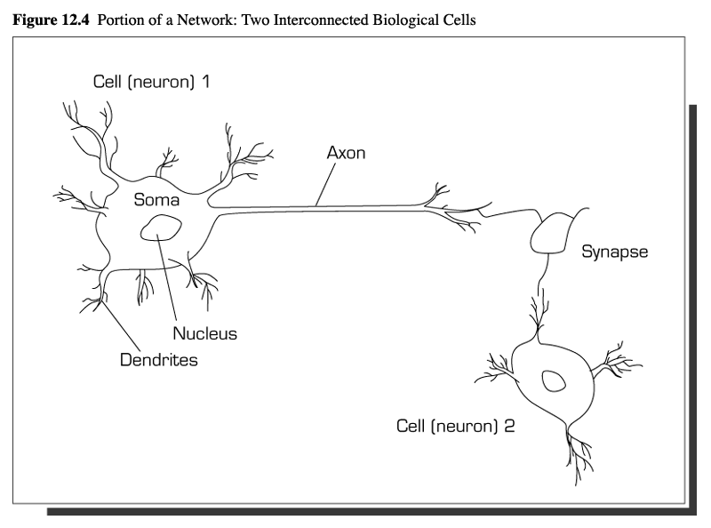
Human Brain

Slide 35
Neural Networks
Artificial neurons connected in network
  Organized by topologies
  Structure
    Three or more layers
      Input, intermediate (one or more hidden layers), output
Receives modifiable signals

Slide 36
Processing
Processing elements are neurons
Allows for parallel processing
Each input is single attribute
  Connection weight
    Adjustable mathematical value of input
  Summation function
    Weighted sum of input elements
    Internal stimulation
  Transfer function
    Relation between internal activation and output
      Sigmoid/transfer function
      Threshold value
Outputs are problem solution

Slide 37
Architecture
Feedforward-backpropogation
  Neurons link output in one layer to input in next
  No feedback
Associative memory system
  Correlates input data with stored information
  May have incomplete inputs
  Detects similarities
Recurrent structure
  Activities go through network multiple times to produce output

Slide 38
Network Learning
Learning algorithms
  Supervised
    Connection weights derived from known cases
    Pattern recognition combined with weighting changes
    Back error propagation
      Easy implementation
      Multiple hidden layers
      Adjust learning rate and momentum
      Known patterns compared to output and allows for weight adjustment
      Established error tolerance
  Unsupervised
  Only stimuli shown to network
  Humans assign meanings and determine usefulness

Slide 39
Development of Systems
Collect data
  The more, the better
Separate data into training set to adjust weights
Divide into test sets for network validation
Select network topology
  Determine input, output, and hidden nodes, and hidden layers
Select learning algorithm and connection weights
Iterative training until network achieves preset error level
Black box testing to verify inputs produce appropriate outputs
  Contains routine and problematic cases
Implementation
  Integration with other systems
  User training
  Monitoring and feedback

Slide 40
Support Vector Machines (SVM)
SVM are among the most popular machine-learning techniques
SVM belong to the family of generalized linear models… (capable of representing non-linear relationships in a linear fashion)
SVM achieve a classification or regression decision based on the value of the linear combination of input features
Because of their architectural similarities, SVM are also closely associated with ANN

Slide 41
Support Vector Machines (SVM)
Goal of SVM: to generate mathematical functions that map input variables to desired outputs for classification or regression type prediction problems
  First, SVM uses nonlinear kernel functions to transform non-linear relationships among the variables into linearly separable feature spaces
  Then, the maximum-margin hyperplanes are constructed to optimally separate different classes from each other based on the training dataset
SVM has solid mathematical foundation!

Slide 42
Support Vector Machines (SVM)
A hyperplane is a geometric concept used to describe the separation surface between different classes of things
  In SVM, two parallel hyperplanes are constructed on each side of the separation space with the aim of maximizing the distance between them
A kernel function in SVM uses the kernel trick (a method for using a linear classifier algorithm to solve a nonlinear problem)
  The most commonly used kernel function is the radial basis function (RBF)

Slide 43
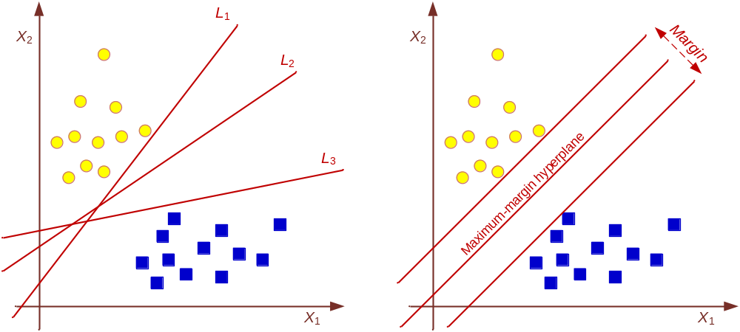
Support Vector Machines (SVM)
Many linear classifiers (hyperplanes) may separate the data

Slide 44
How Does a SVM Works?
Following a machine-learning process, a SVM learns from the historic cases
The Process of Building SVM
  1. Preprocess the data
    Scrub and transform the data
  2. Develop the model
    Select the kernel type (RBF is often a natural choice)
    Determine the kernel parameters for the selected kernel type
    If the results are satisfactory, finalize the model, otherwise change the kernel type and/or kernel parameters to achieve the desired accuracy level
  3. Extract and deploy the model

Slide 45
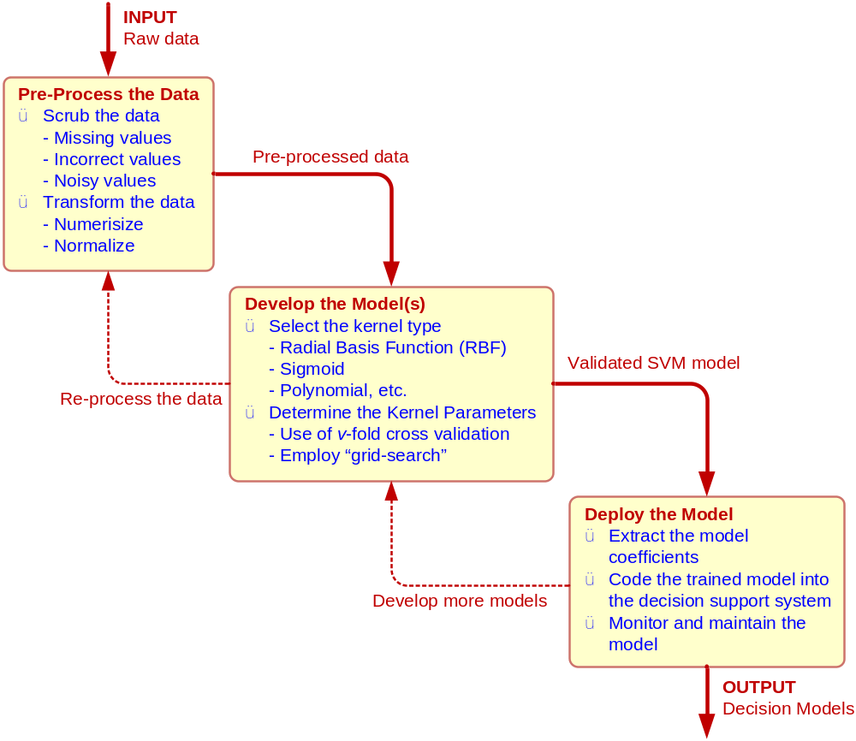
The Process of Building a SVM

Slide 46
SVM Applications
SVM are the most widely used kernel-learning algorithms for wide range of classification and regression problems
SVM represent the state-of-the-art by virtue of their excellent generalization performance, superior prediction power, ease of use, and rigorous theoretical foundation
Most comparative studies show its superiority in both regression and classification type prediction problems
See recent literature and examples in the book
SVM versus ANN?

Slide 47


Intelligent Software Agents
Intelligent Agent (IA): is an autonomous computer program that observes and acts upon an environment and directs its activity toward achieving specific goals
Relatively new technology
Other names include
  Software agents
  Wizards
  Knowbots
  Intelligent software robots (Softbots)
  Bots
Agent - Someone employed to act on one’s behalf

Slide 48
Definitions of Intelligent Agents
Intelligent agents are software entities that carry out some set of operations on behalf of a user or another program, with some degree of independence or autonomy and in so doing, employ some knowledge or representation of the user’s goals or desires.”
(“The IBM Agent”)
Autonomous agents are computational systems that inhabit some complex dynamic environment, sense and act autonomously in this environment and by doing so realize a set of goals or tasks for which they are designed
(Maes, 1995, p. 108)

Slide 49
Characteristics of Intelligent Agents
Autonomy (empowerment)
  Agent takes initiative, exercises control over its actions. They are Goal-oriented, Collaborative, Flexible, Self-starting
Operates in the background
Communication (interactivity)
Automates repetitive tasks
Proactive (persistence)
Temporal continuity
Personality
Mobile agents
Intelligence and learning
Notes:
أتمتة المهام المتكررة
استباقية (مثابرة)
الاستمرارية الزمنية
الشخصية
وكلاء المحمول
الذكاء والتعلم

Slide 50
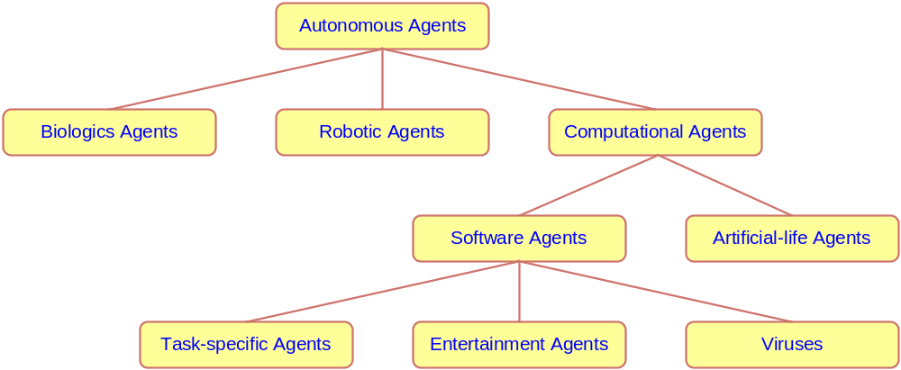
A Taxonomy for Autonomous Agents

Slide 51
Classification for Intelligent Agents by Characteristics
Agents can be classified in terms of these three important characteristics dimensions
  1. Agency
    Degree of autonomy and authority vested in the agent
      More advanced agents can interact with other agents/entities
  2. Intelligence
    Degree of reasoning and learned behavior
      Tradeoff between size of an agent and its learning modules
  3. Mobility
    Degree to which agents travel through the network
      Mobility requires approval for residence at a foreign locations

Slide 52
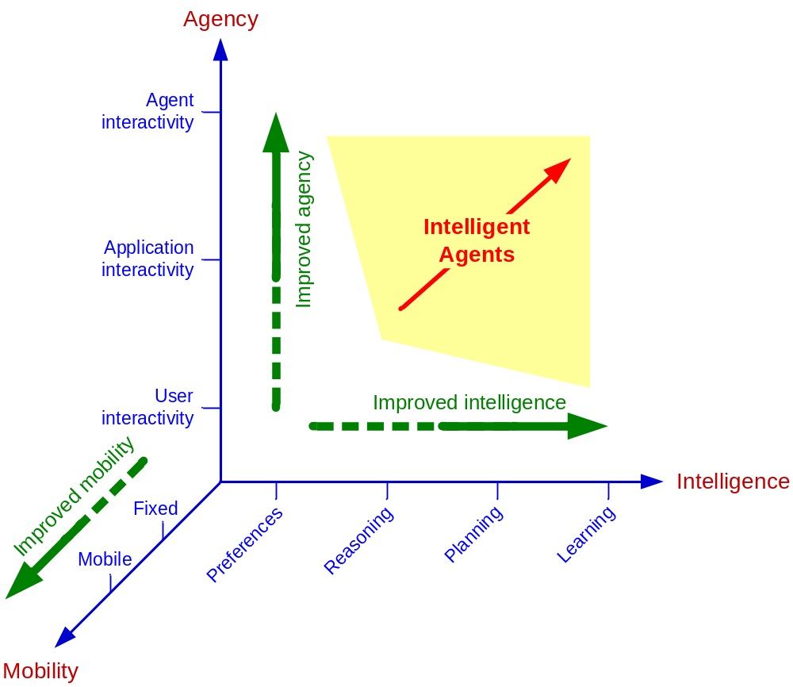
Intelligent Agents’ Scope in Three Dimensions

Slide 53
Internet-Based Software Agents
Software Robots or Softbots
Major Categories
  E-mail agents (mailbots)
  Web browsing assisting agents
  Frequently asked questions (FAQ) agents
  Intelligent search (or Indexing) agents
  Internet softbot for finding information
  Network Management and Monitoring
    Security agents (virus detectors)
  Electronic Commerce Agents (negotiators)

Slide 54
Leading Intelligent Agents Programs
IBM [research.ibm.com/iagents]
Carnegie Mellon [cs.cmu.edu/~softagents]
MIT [agents.media.mit.edu]
University of Maryland, Baltimore County [agents.umbc.edu]
University of Massachusetts [dis.cs.umass.edu]
University of Liverpool [csc.liv.ac.uk/research/agents]
University of Melbourne (<URL>agentlab.unimelb.edu.au</URL>)
Multi-agent Systems [multiagent.com]
Commercial Agents/Bots [botspot.com]

Slide 55
End of the Chapter
Questions / comments…

Slide 56

All rights reserved. No part of this publication may be reproduced, stored in a retrieval system, or transmitted, in any form or by any means, electronic, mechanical, photocopying, recording, or otherwise, without the prior written permission of the publisher. Printed in the United States of America.
Copyright © 2011 Pearson Education, Inc.
Publishing as Prentice Hall

